Slide 1
Econ 100 Principles of Economics
Lecture 7
March 20

Slide 2
Today
Ultimatum game

Slide 3
Last week, we saw how two individuals can successfully cooperate and improve their welfare.
They cooperate because cooperation allows them to consume more sandwiches.
Now let us focus more on the “dividing the gains/surplus” part:
This is a situation with some conflict of interest.

Slide 4
INSTRUCTIONS
There is 50 TL to split between a proposer and a responder.
The proposer proposes how much of 50 TL to keep for himself/herself and give the remaining to the responder.
The responder either accepts or rejects.
If the responder accepts, then the proposal is enacted. If the responder rejects, then both get 0.

Slide 5
Proposal Number: 31415
EXAMPLE
THE PROPOSER:
I propose to keep _49__ TL for myself and give __1___ TL to the responder.
THE RESPONDER
_______ I accept, and earnings will be determined by the proposal.
__XXX__ I reject, and both of us will get 0.

Slide 6
Let’s talk about this

Slide 7
Ultimatum Game
Individual 1 offers x (out of 50) to Individual 2. If the latter accepts, they get 50-x and x, respectively; otherwise, they both get zero.
What did students do last year?
Offer | # of offers (total: 29) | # rejections
1 | 5 | 2
5 | 1 | 1
15 | 3 | 2
17,3 | 1 | 0
19 | 1 | 0
20 | 4 | 1
24 | 2 | 0
25 | 8 | 0
30 | 1 | 0
35 | 1 | 0
45 | 1 | 0
49 | 1 | 0
Mean offer | Mode offer | Rejection rate | Low offer Rejection rate
29.14 | 25 | % 20.7 | % 50

Slide 8
Ultimatum Game
Individual 1 offers x (out of 30) to Individual 2. If the latter accepts, they get 30-x and x, respectively; otherwise, they both get zero.
Offer | #offers (total:24) | #rejections
1 | 3 | 2
3 | 1 | 1
5 | 3 | 3
9 | 1 | 1
10 | 4 | 2
12 | 1 | 0
13 | 1 | 0
14 | 3 | 1
15 | 6 | 0
16 | 1 | 0
Mean offer | Mode offer | Rejection rate | Low Offer Rejection Rate
10.125 | 15 | 42% | 100%

Slide 9
THE ULTIMATUM BARGAINING LITERATURE

Slide 10
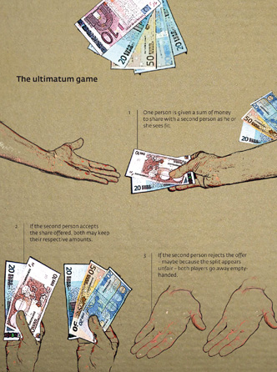
If you search for
“ultimatum bargaining” on scholar.google.com,
you will find more than
24,000 results.

Slide 11
Werner Güth, Rolf Schmittberger, and Bernd Schwarze
“An experimental analysis of ultimatum bargaining,”
“Journal of Economic Behavior & Organization Volume 3, Issue 4, December 1982, Pages 367–388.
The first sentence:
“There are many experimental studies of bargaining behavior, but surprisingly enough nearly no attempt has been made to investigate the so-called ultimatum bargaining behavior experimentally.”

Slide 12
Since then thousands of ultimatum game experiments and extensions have been published.

Slide 13
Initially, researchers used the ultimatum game to study bargaining and to document limits of the assumptions of rationality, material selfishness, or opportunism.

Slide 14
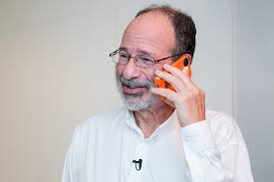
“Bargaining and Market Behavior in Jerusalem, Ljubljana, Pittsburgh, and Tokyo: An Experimental Study” 1991
Authors: Alvin Roth*, Vesna Prasnikar, Masahiro Okuno-Fujiwara, and Shmuel Zamir
College students are asked to play the “Ultimatum bargaining game”.
*Al Roth
2012 Nobel prize in Economics

Slide 15
Results
The most common offer in all 4 countries were in the range of 40 - 50 % of the total.
In Yugoslavia and the U.S. it was 50%,
In Japan and Israel it was closer to 40%.
Rejection rates were not higher in Japan and Israel.
The authors thought that the differences are due to “cultural norms” about what constitutes a reasonable demand!

Slide 16
Summary of known facts
Thousands of research projects papers and books

Slide 17
Summary of known facts
On average, proposers offer 40% of the total amount to the responder.
Offers are rejected about 15-20% of the time.
Lower offers are more likely to be rejected.

Slide 18
Why so many additional studies are needed?

Slide 19
We still cannot predict individual behavior in the ultimatum game based on observables!
Amount to be split (large or small)? Ultimatum games played with larger amounts of money to be divided show that the size of the money does not significantly affect behavior.
Age (Example: older people offer a larger amount?)
Gender (Example: females offer a larger amount?)
Education
Culture / religion

Slide 20
Let’s have a brief discussion

Slide 21
Let’s try to find well formulated (precise, to the point, not vague) responses to the following three questions:
What will be the most likely outcome in ultimatum bargaining if both the proposer and the responder are motivated purely by monetary considerations? Most common offer? Rejection rates?
Why do responders reject offers?
Is it possible that the proposers are selfish and are behaving “rationally” given responder behavior?

Slide 22
#1 has a correct answer!
If both participants care only about their monetary payoffs,
the responder should accept any positive offer
the proposer should anticipate this and only offer a very small amount of money.
The proposer should get almost the entire amount of money.
All offers are accepted. No money is left on the table.

Slide 23
#2 This is open ended
Why are “good” offers rejected?
Perhaps the responders want to punish greed.
Perhaps they have a concern for fair outcomes.

Slide 24
Does it seem that proposers are behaving “rationally” given responder behavior?

Slide 25
A critical question:
Are proposers trying to be fair or are they reacting strategically?
e.g., “trying to make the smallest acceptable offer”

Slide 26

The dictator game!

Slide 27

The dictator game
Robert Forsythe, Joel L. Horowitz, N. E. Savin, and Martin Sefton, 1994, “Fairness in Simple Bargaining Experiments”
Player 1 proposes to split a fixed sum of money with player 2.
Player 2 cannot reject the proposal.
The proposal is enacted.

Slide 28
What is your guess?
How much money (say out of 50 TL) will the dictator give to the responder?

Slide 29
Results
In the case of the $10 game, 80% left a positive amount of money.
20% left half. ($5)
The modal offer was $3.

Slide 30
Consider the “market game” (Prasnikar and Roth 1992)
There are 9 buyers and 1 seller.
The buyers try to purchase an item worth 1000 tokens to them.
Each buyer simultaneously makes an offer to the seller (in 5 token units).
The seller can either accept or reject the highest offer. If he accepts it, the item is sold at the proposed price and all of the other buyers get zero. If the seller rejects the high offer, everybody get 0.
If participants are selfish, the high offer should either be 995 or 1000 and the offer should always be accepted.
In experiments, the behavior rapidly converges to this outcome.

Slide 31
What would you do?

Slide 32
PART I
Imagine a world in which it is a known fact that everybody tries to maximize their own material gains in interactions with others.
In the “splitting 50 TL game” what is the smallest amount of money the responder will accept?
How much money will the proposer offer to the responder?

Slide 33
PART II
Forget that selfish world, you are now back to the real (your) world.
In the “splitting 50 TL game” what would be the smallest amount of money YOU will accept if you are the responder? Why will YOU not accept a smaller amount?
In the “splitting 50 TL game” how much money will YOU offer to the responder if YOU are the proposer? Why will you not offer a larger amount? Why will you not offer a smaller amount?

Slide 34
PART I and II together
PART I: Imagine a world in which it is a known fact that everybody tries to maximize their own material gains in interactions with others.
In the “splitting 50 TL game” what is the smallest amount of money the responder will accept?
How much money will the proposer offer to the responder?
PART II: You are now back to the real (your) world.
In the “splitting 50 TL game” what would be the smallest amount of money YOU will accept if you are the responder? Why will YOU not accept a smaller amount?
In the “splitting 50 TL game” how much money will YOU offer to the responder if YOU are the proposer? Why will you not offer a larger amount? Why will you not offer a smaller amount?

Slide 35
A very interesting study

Slide 36
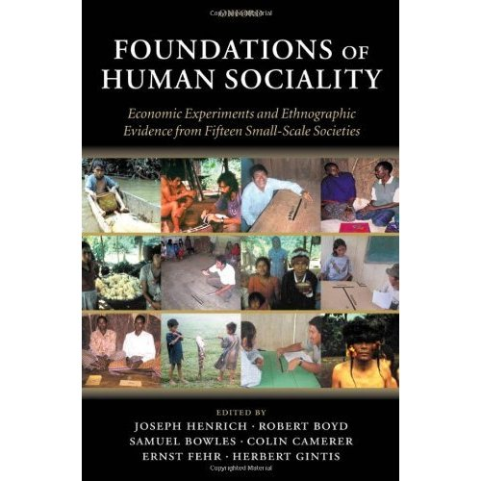

Slide 37
Ultimatum game results of an experimental study 15 small, indigenous societies around the world
Foundations of Human Sociality: Economic Experiments and Ethnographic Evidence from Fifteen Small-Scale Societies
Joseph Henrich, Robert Boyd, Samuel Bowles, Colin Camerer, Ernst Fehr, and Herbert Gintis, Oxford University Press 2004
In Search of Homo Economicus: Behavioral Experiments in 15 Small-Scale Societies, The American Economic Review, 91:2, (May, 2001), pp. 73-78
Joseph Henrich, Robert Boyd, Samuel Bowles, Colin Camerer, Ernst Fehr, Herbert Gintis, and Richard McElreath

Slide 38
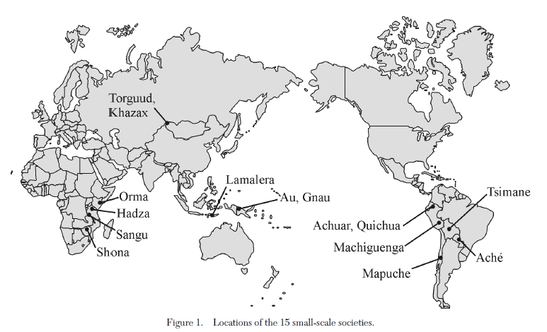

Slide 39

Lamelara whale-hunters (Indonesia)

Slide 40

Lamelara whale-hunters (Indonesia)
http://www.youtube.com/watch?v=_tqW8YZDE9o

Slide 41
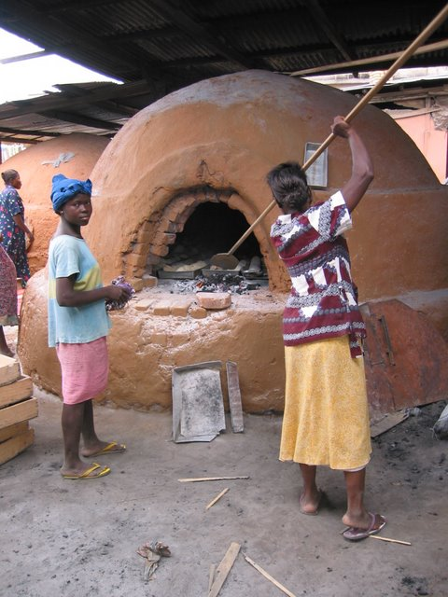
Barr, Ghana

Slide 42
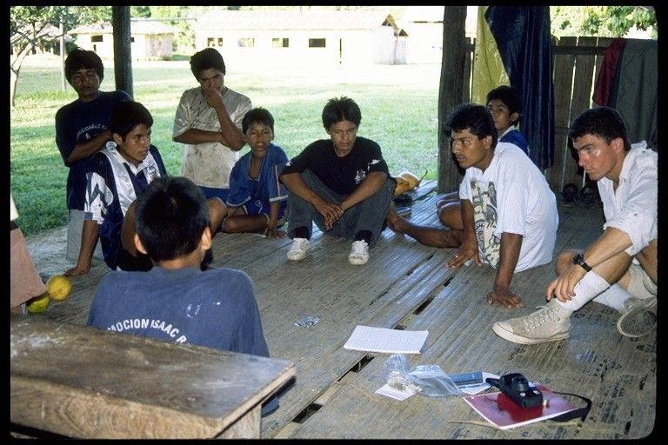
Machiguenga, Peru

Slide 43
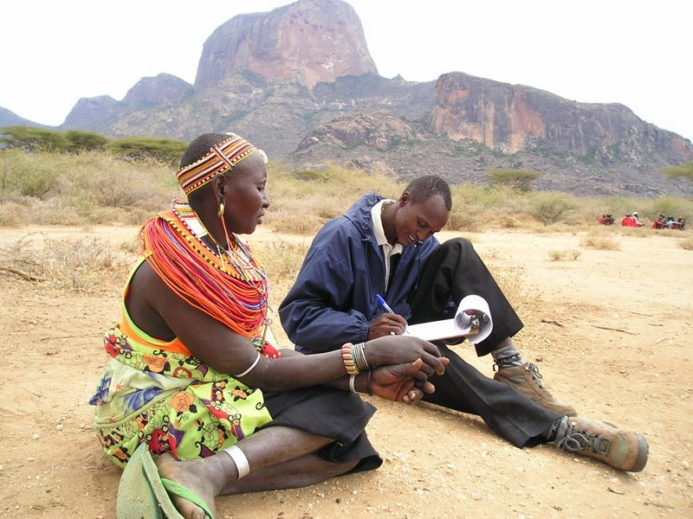
Samburu (Kenya)

Slide 44
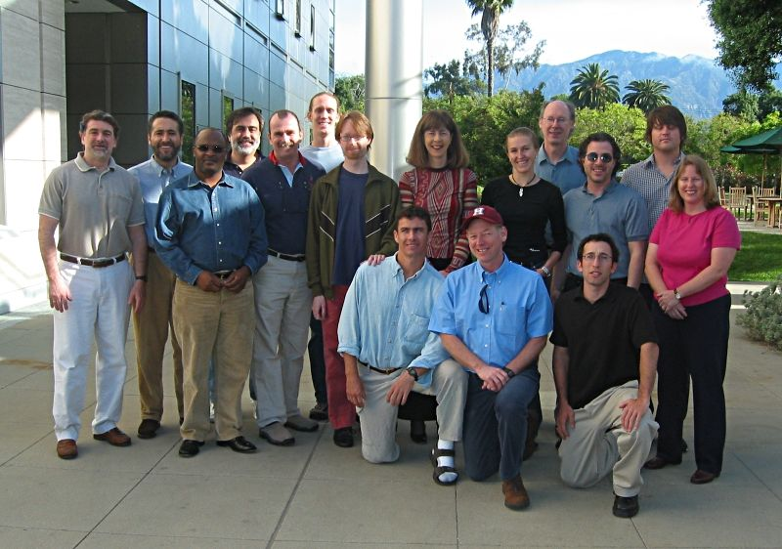
Pasadena (USA)

Slide 45
Findings
Higher variation in behavior is observed across cultures.

Slide 46
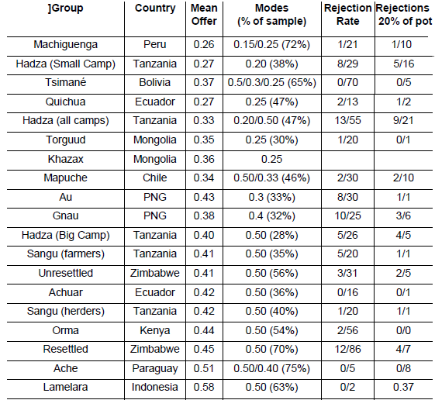

Slide 47
Findings
Pure material self-interest is never observed.
In none of the small societies was people’s behavior in the ultimatum game consistent with the selfishness axiom.
Age, gender, socio-economic status, risk-aversion, size of the stake etc. did not affect behavior.

Slide 48
So, what matters?
Market integration and the importance of cooperation in economic activities!
Splits are more equal in cultures where people must work cooperatively rather than alone/independently.
Splits are more equal in cultures where people are more exposed to market transactions.

Slide 49
Machiguenga, Peru

Slide 50
Machiguenga, Peru
Mean offer = 26%, mode = 15%
Socially disconnected, live apart, economic isolation

Slide 51
Lamelara whale-hunters (Indonesia)

Slide 52
Lamelara whale-hunters (Indonesia)
Mean offer = 58%, mode = 50%

Slide 53
Economics: The emphasis on preferences
A narrow interpretation of economics: People are self-interested. Thus, fair offers and the rejection of low offers are in contradiction with the prediction of the theory. (What’s wrong with these people?)
A broader interpretation: Rejections of unfair offers by the responder reveal preferences for fair divisions by these individuals. Economics does not care about the thought process the individuals go through and takes these preferences as given.

Slide 54
A different explanation
Economics
Psychology
Behavioral Economics, Experimental Economics
+
Neuroscience
=
Neuroeconomics
54

Slide 55


Example of MRI (magnetic resonance imaging) scanner
Scanner
a very powerful electro-magnet
field strength of 3 teslas (T), ~60,000 times greater than the Earth’s field
During the experiment:
subject lies in the scanner and is exposed to the stimuli
scanner tracks the signal throughout the brain (fMRI)
55

Slide 56
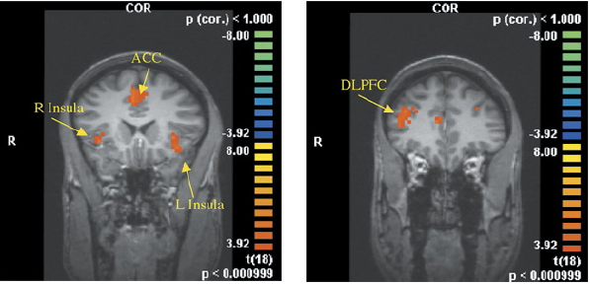
Ultimatum games: This is your brain on unfairness (Sanfey, Rilling et al, Science Vol.300 June 2003)
Bilateral Anterior Insula: negative emotional states (pain, distress,
hunger, thirst, etc.) ACC detection of conflicts;
DLPFC (dorsolateral prefrontal cortex): cognitive process: goal
maintenance, executive control
56

Slide 57
A methodological note:
A cue or complement?

Slide 58
Coffee-cigarettes: Psychologists and economists ask different type of questions about the consumption of these two together.
Psychology
Cue: a stimulus that triggers a desire or a craving for a particular activity or consumption
Economics
Complements: demand-price relation (fork-knife)

Slide 59
Different objectives demand different abstractions.
Psychology and economics ask different questions, thus their methodologies and abstractions are different.

Slide 60
End of the lecture

